Slide 1
The impact of oil prices on the gas prices

Slide 2



Team Members
Rita
Juan
Sheela
Rita works at Frontier
Communications as a Network Planner. At her director’s prompting, she chose the Berkeley Bootcamp Data Analytics program to gain relevant analysis skills.
Juan works at Kings Hawaiian as Business Solution Analyst in the Data & Technology Services department. He is very excited to learn about ML and to be able to use it at his work, which will enable ML Analysis.
Sheela graduated from UC Berkeley in 2017 with a degree in Human Biology. Currently is a project manager at AstraZeneca. She is passionate about using data to support business development and growth needs of healthcare systems and biopharmaceuticals.

Slide 3
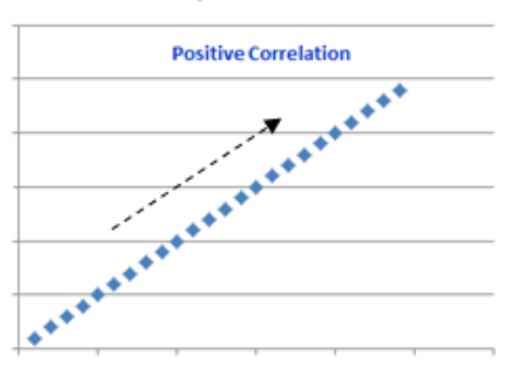
Claim
The question posed in this project is “what is the correlation between oil prices and gas prices?” The hypothesis is that there will be a strong positive correlation between the oil prices data set and the gas prices data set.
Notes:
Speaker notes: ( Elaborate on what a positive correlation is) A Positive correlation means that as oil prices increase, gas prices will also increase.

Slide 4
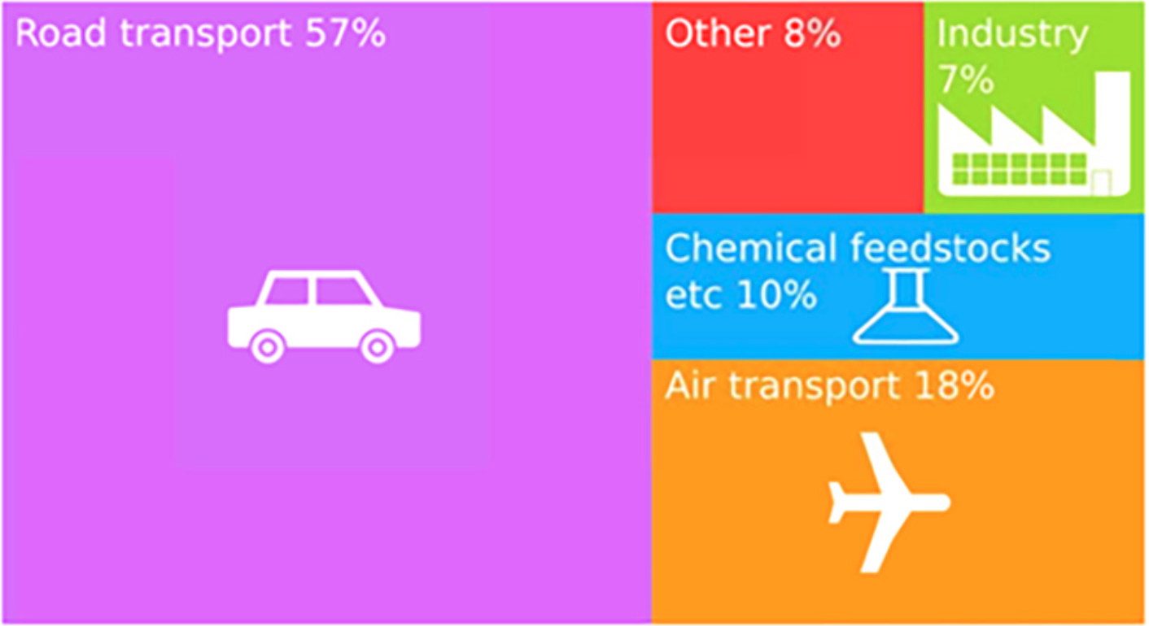
Project Background
The goal of this project is to establish a correlation between oil prices and gas price.
This project has real world applications because oil prices will impact transportation, manufacturing and production of goods. Oil prices will also strongly impact the way people travel and will allow for greater discretionary income.
Notes:
Speaker notes: Specifically talk about transportation, a shipping company looking to lower costs can use this data to better understand when to ship an item across the country using the predictive model established by the correlation of oil and gas prices
lifeblood of the industrialised nations Oil has become the world's most important source of energy since the mid-1950s. Its products underpin modern society, mainly supplying energy to power industry, heat homes and provide fuel for vehicles and aeroplanes to carry goods and people all over the world. Oil’s refined products are used to manufacture almost all chemical products, such as plastics, fertilisers, detergents, paints and even medicines, plus a whole host of other products that you might not expect. Most oil is used for transport

Slide 5
Data Exploration
For this project, we have chosen to analyze data sets of oil and gas prices throughout the last decade. These datasets will help establish a trend and can be used to identify any fluctuations in oil and gas prices
The data sets provide a weekly overview of the relationship between oil and gas prices
The technologies used during the data exploration segment are Jupyter Notebook, pgAdmin4, Python, Tableau, Scikit
Notes:
Speaker note: mention that the data sets will help us answer the question of whether or not there is a correlation between the oil and gas prices

Slide 6

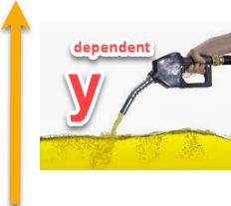
Machine Learning Model
To visualize the correlation between oil and gas prices, we are utilizing a linear regression model
Linear regression is a type of regression analysis where there is a linear relationship between the independent and dependent variable
The independent variable lies on the x axis
The dependent variable lies on the y axis
For this project, the independent variable is the oil prices, the dependent variable is the gas prices
Notes:
Speaker Notes: (say after 1st bullet point) Prior to delving into linear regression, it is first important to understand the term regression. Regression is a modelling method used to identify a target value based on independent predictors
y = mx + b / scikitlearn.LinearRegression

Slide 7
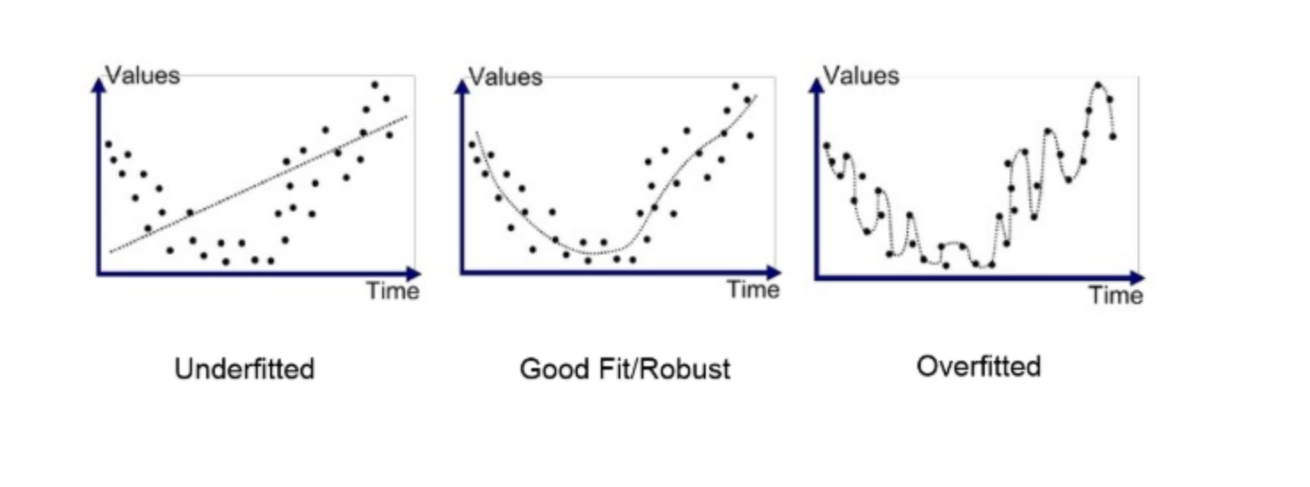
Linear Regression
Notes:
https://www.ecosia.org/images?q=linear+regression+line#id=F25EA6D5BC19D0AC83B34C93415AF7C4100D68A1

Slide 8

Benefits of Linear Regression for Oil Data Analysis
Linear regression is a supervised machine learning model
Assumes nothing about the data, heuristics are not used
Fast execution
No autocorrelation of errors
No outlier distortion
Notes:
Speaker notes: (say after last bullet) All of these qualities are desirable for very large and complex datasets such as the ones we are using for this project.

Slide 9

Accuracy of Linear Regression
The linear regression line is an accurate model because it establishes a correlation between two values that have dependencies on each other
It is also an accurate predictor of future trends. In this project we will be able to use the established correlation between oil and gas prices to determine how fluctuations in the price of oil will affect future changes in gas price.
Notes:
Speaker Notes: Using the Linear Regression model predictions and comparing to actual results we can see we have a very accurate model as we will show during data analysis

Slide 10
Data Analysis
Working Code Link: https://github.com/skotagiri95/Oil-and-Dollar-Value-Analysis-/tree/master/LINEAR%20REGRESSION_OIL
Oil is independent variable and gas price is the dependent variable. The formula utilized P-value: <0.0001, Equation: Gas Price ($) = 0.0212924*Oil Price ($) + 1.50941
Moved from a monthly comparison of the variables to a week by week comparison.
Notes:
Description of data preprocessing
✓ Description of feature engineering and the feature selection, including the team's decision-making process
This change allowed the data to be clear and concise. The dataset went from 10,964 inputs to 834.
Description of how data was split into training and testing sets, we went from a monthly comparison to a weekly comparison

Slide 11
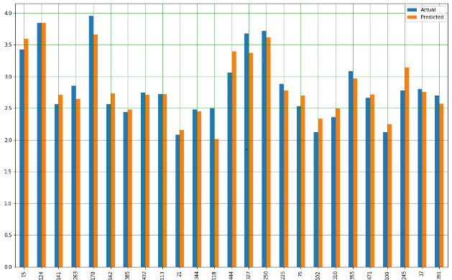
Data Analysis
Data was split into a 70%-30% datasets. After training and testing the results, the data fell within the actual data versus the prediction.
The linear regression model works well we you have an dependent value such as gas and independent value such as oil.
The advantage of linear regression allows for an easy modeling of your dependent and dependent values. The disadvantage is it can only be used with linear data.
Notes:
Description of data preprocessing
This model choice is quick and clearly displays the dependent gas prices on the independent oil price axis
Description of how model was trained..
With this graph you can see the accuracy of the model

Slide 12
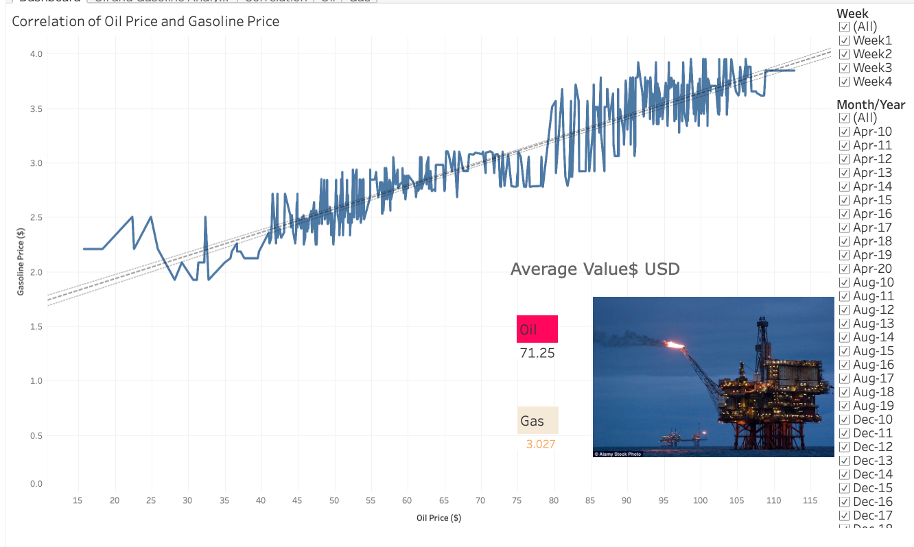
Project Dashboard
https://public.tableau.com/profile/juan.m.pacheco#!/vizhome/OilAnalysis_15884725810310/Dashboard
Notes:
We chose tableau to allow interactive participation of the data. You can select a data point and see the specific year or month and view the results.

Slide 13
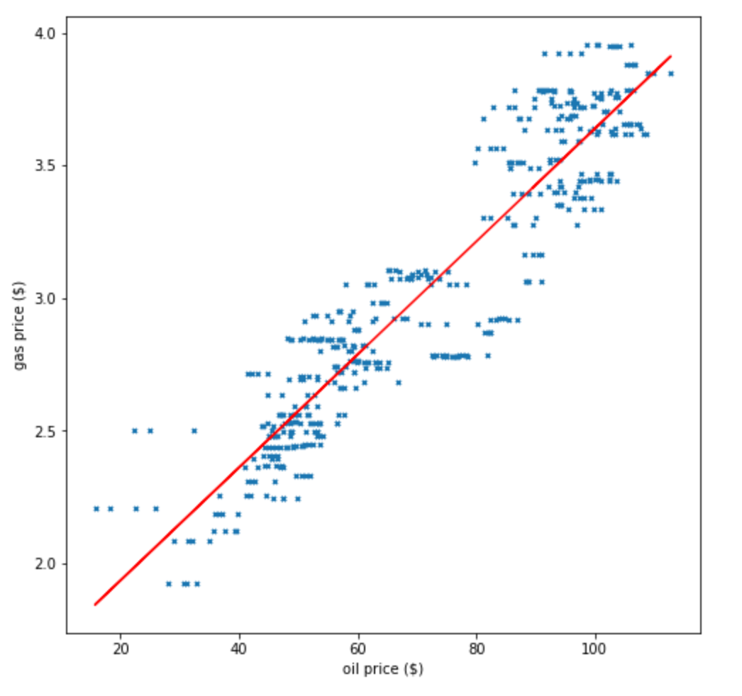
Results of Data Analysis
The results show us that there is a strong positive correlation between the oil prices and gas prices
We explored the best fit line while changing the number of data points in the model and the line showed no difference in the slope
Notes:
Speaker notes: (say after 1st bullet) This means that as gas prices increase, oil prices also increase. If we were to approach this problem in a different manner, we would have chosen to analyze the data either state by state or compare different countries.

Slide 14



Future Exploration
For future work, we would like to examine the effect external factors will have on the correlation between oil and gas prices
External factors include
Pandemic
Election
A natural disaster
Notes:
Speaker notes: the same algorithm used to establish a correlation between oil and gas prices can be used to analyze how world events will impact oil and gas prices

Slide 15
Resources
https://www.investopedia.com/articles/investing/032515/how-oil-prices-impact-us-economy.asp
https://towardsdatascience.com/introduction-to-machine-learning-algorithms-linear-regression-14c4e325882a
https://economictimes.indiatimes.com/markets/commodities/news/oil-spikes-30-logs-biggest-one-day-rise-after-trump-says-saudis-and-russians-to-cut-output/articleshow/74953484.cms
https://www.whatissixsigma.net/wp-content/uploads/2013/12/Correlation-V1.0-Figure-A-and-B.png
Notes:
Suggestions: Oil prices trends, add in market for coronavirus

